Slide 1
AUTO QC SYSTEM PROPOSAL based on Deep Learning Algorithm using Python , R

Slide 2
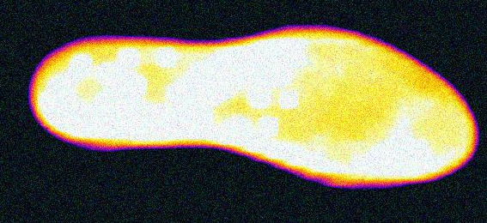
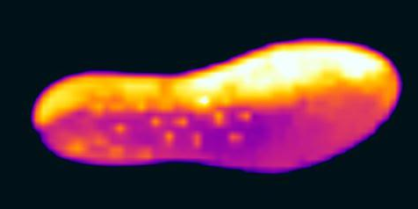
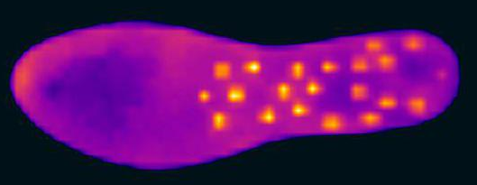
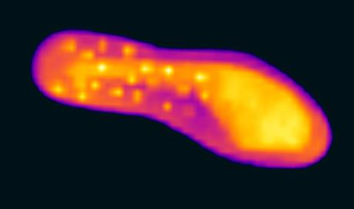
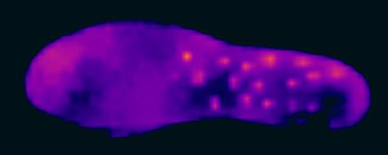
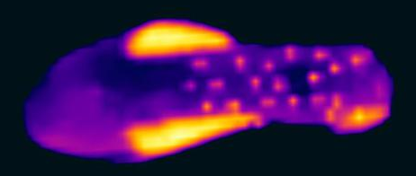
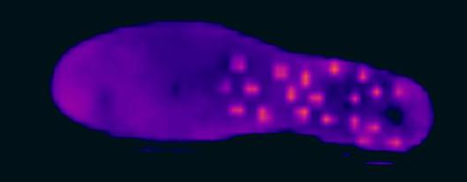
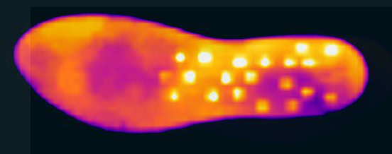
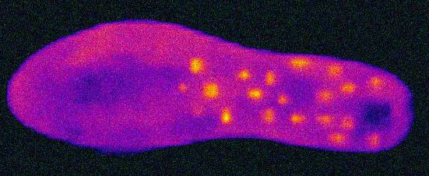
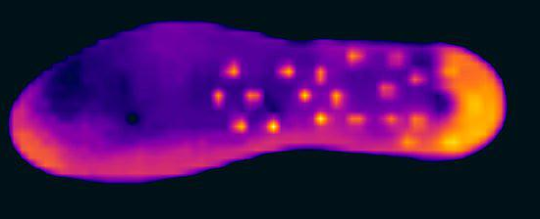
Thermal Image Right after getting out of oven
Training Image (Classified as good!)
Training Image (Classified as NG!)
SRPAY

Slide 3
DATA TRANSFORMATION (IMAGE to PIXEL ARRAY)
28 columns
Array (28 X 28) = 784 Pixel data
0 | 0 | 0 | 0 | 0 | 0 | 0 | 0 | 0 | 0
0 | 0 | 0 | 0 | 200 | 181 | 174 | 0 | 0 | 0
0 | 0 | 220 | 210 | 230 | 190 | 189 | 179 | 175 | 0
0 | 210 | 220 | 230 | 140 | 185 | 175 | 154 | 248 | 232
210 | 220 | 230 | 140 | 185 | 175 | 154 | 248 | 232 | 163
0 | 189 | 154 | 187 | 200 | 204 | 214 | 234 | 214 | 0
0 | 0 | 254 | 232 | 211 | 210 | 198 | 178 | 0 | 0
0 | 0 | 0 | 154 | 134 | 218 | 213 | 0 | 0 | 0
28 Rows
Range of pixel: Numeric value 0~255

Slide 4
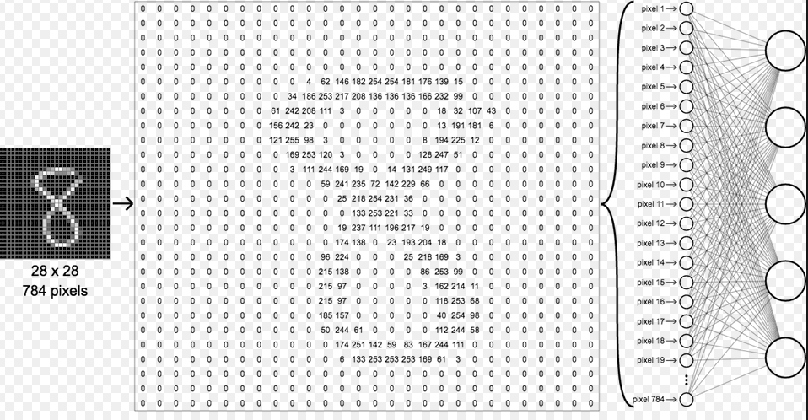
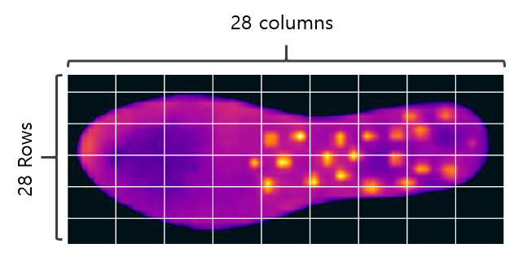
Fitting Pixel array to Neural Network system

Slide 5
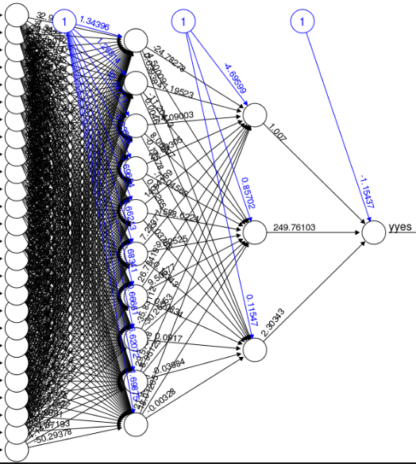
Fitting Pixel array to Neural Network algorithm
Deep Learning Algorithm
Using Neural Network
(Input = 784,
Depth of Hidden layer = 50
Output = 2 (Ok,Ng))
Output
OK
Input: 28 X 28 = 784
NG

Slide 6
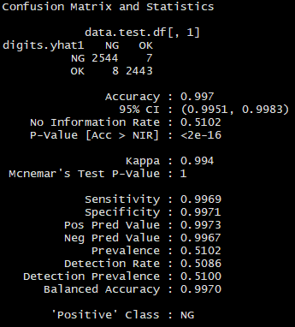
INITIAL TEST RESULT
Result seems very promising!!
Result summary of initial test using neural network
No. Training data: 13,000
No. validating data: 5,000
Structure of neural network: Depth of layer- 50levels
Classification Accuracy: 99.7%
Type 1 error : 8 out of 2451 (0.33%)
Type 2 error : 7 out of 2551 (0.27%)

Slide 7
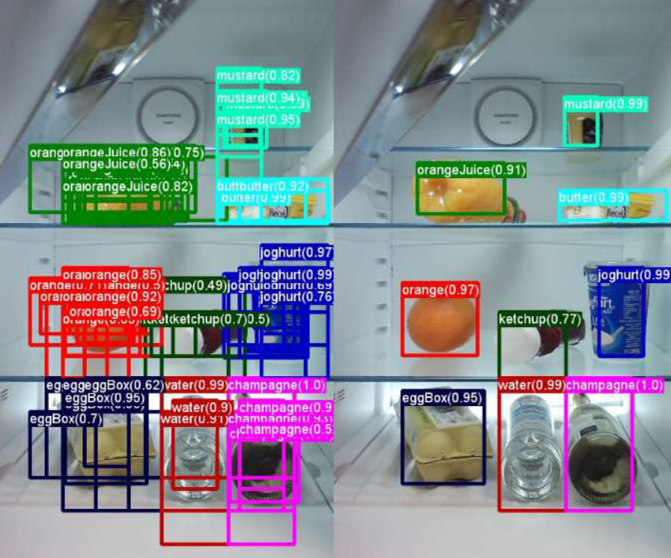
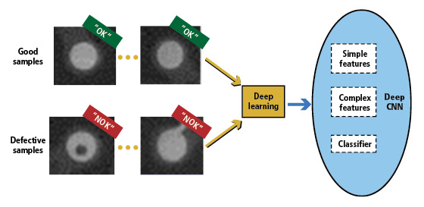
NEXT STEP
Result summary of initial test using neural network
Try more variant type of NG part to build up more leveraged classification algorithm.
Combine object detecting function
Target output would be…

